Slide 1

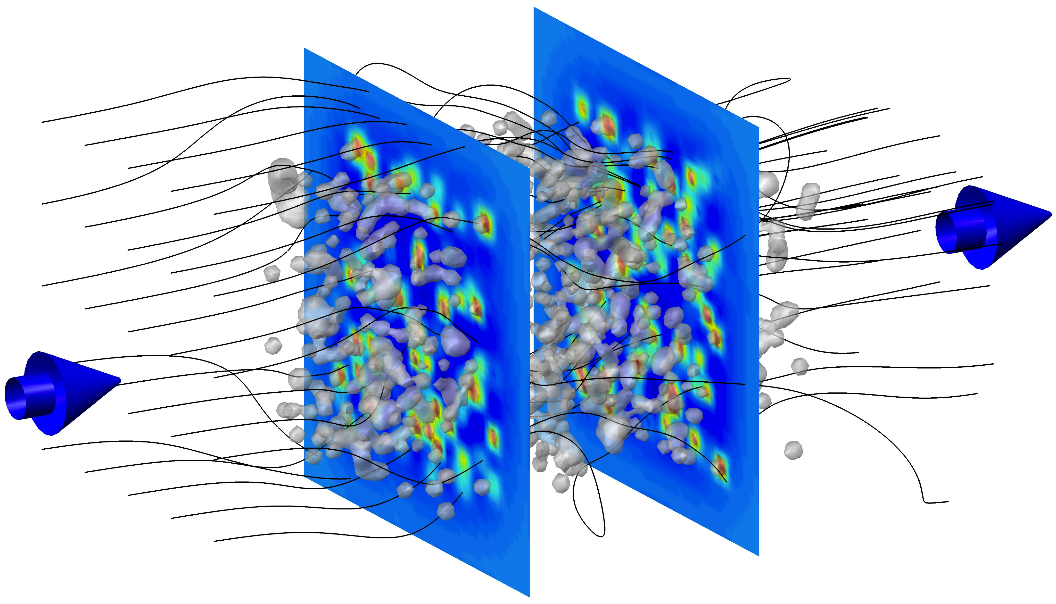
Fluid Dynamics in Manifolds Using Lattice Kinetic Theory
Miller Mendoza Jiménez
Collaborations: Jens-Daniel Debus, Hans J. Herrmann, Sauro Succi, Jose D. Muñoz C.
Notes:
/home/mmendozaj/ETH-design/presentation-openoffice/template_praesentation_oo.odp

Slide 2
Table of Contents
Motivation
Kinetic Theory and Boltzmann Equation in Manifolds
Fluid Dynamics in Manifolds
Boundary Conditions
Taylor-Couette instability
Campylotic medium
Wave equation in contravariant coordinates, with a simple example.
Summary
Some
background
Model and some applications

Slide 3
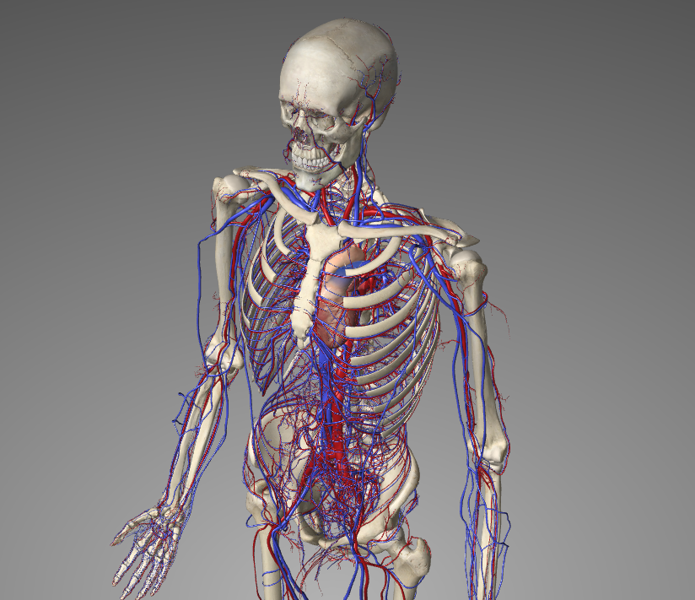
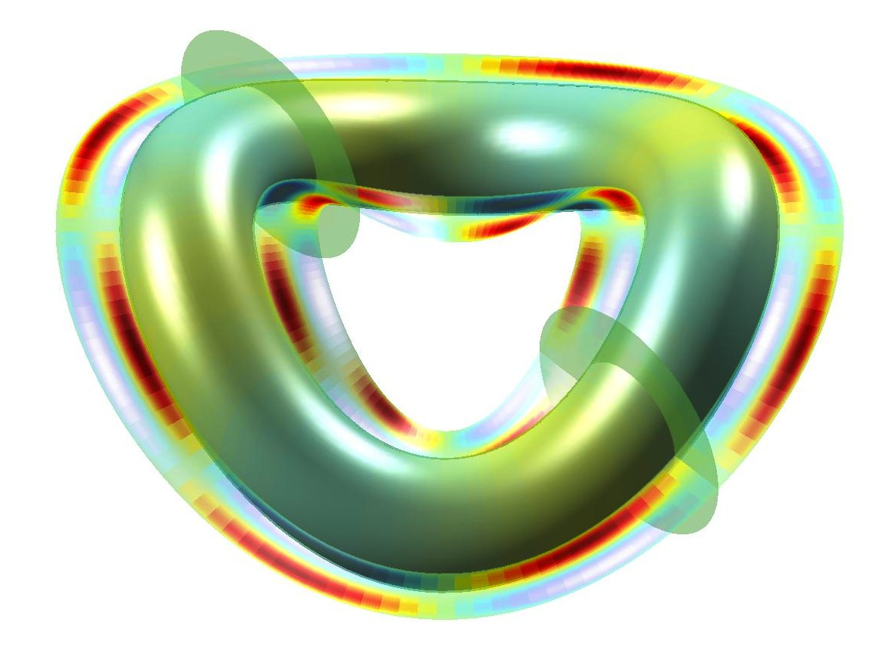
Fluid Dynamics Examples
Vessels
Generalized curved spaces
^{J.} _{Appl.} ^{Phys. 64, 6365 (1988).}
Curved boundary conditions
Graphene Semiconductor Möbius band

Slide 4
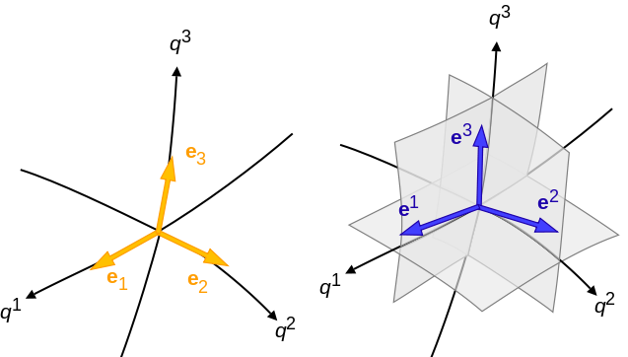
Key: Working with contravariant components of vectors
Metric tensor

Slide 5
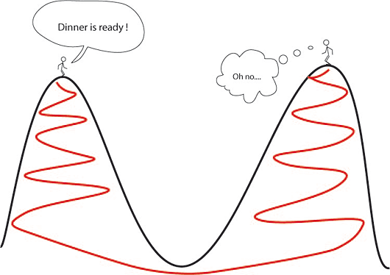
Measure of the distance
Two infinitesimally separated points
Two separated points, is an arbitrary parameter, and is the trajectory joining them.

Slide 6
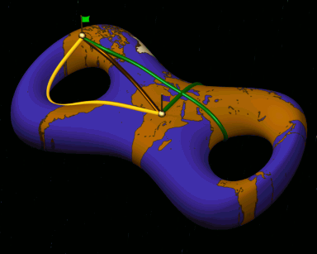
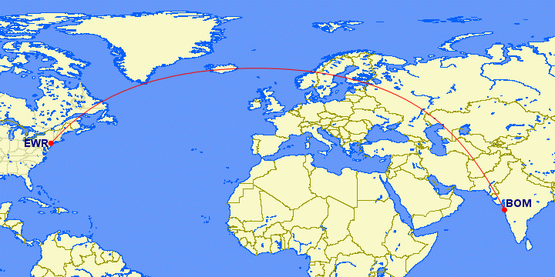
Geodesics: Shortest path
Geodesic equation:
For a particle:
Geodesic equation contains
inertial forces:

Slide 7
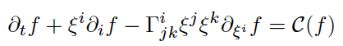
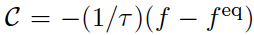
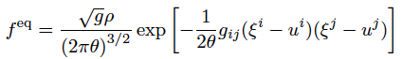
Boltzmann Equation in Manifolds
Taking into account that particles move along geodesics:
Add a forcing term
BGK:
This is also the case for the Boltzmann equation in curvilinear coordinates (polar, cylindrical and spherical coordinates).
In thermodynamic equilibrium
P. J. Love and D. Cianci, Phil. Trans., of the Royal Soc. A 369, 2362 (2011).
: Microscopic Velocity
Anisotropic Gaussian Shape:
Hermite polynomials expansion possible !!
: Macroscopic Velocity
: Normalized Temperature

Slide 8
Expansion and Lattice Configuration

Slide 9
Expansion and Lattice Configuration
To ensure Hydrodynamics: First four moments of the equilibrium distribution.
D3Q41

Slide 10
Christoffel Symbols and Boltzmann Equation
To ensure Hydrodynamics: Expansion up to third order Hermite polynomials.
D3Q41

Slide 11
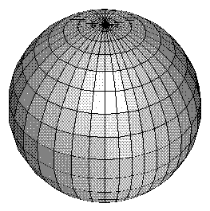
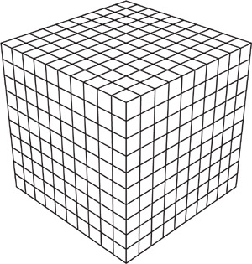
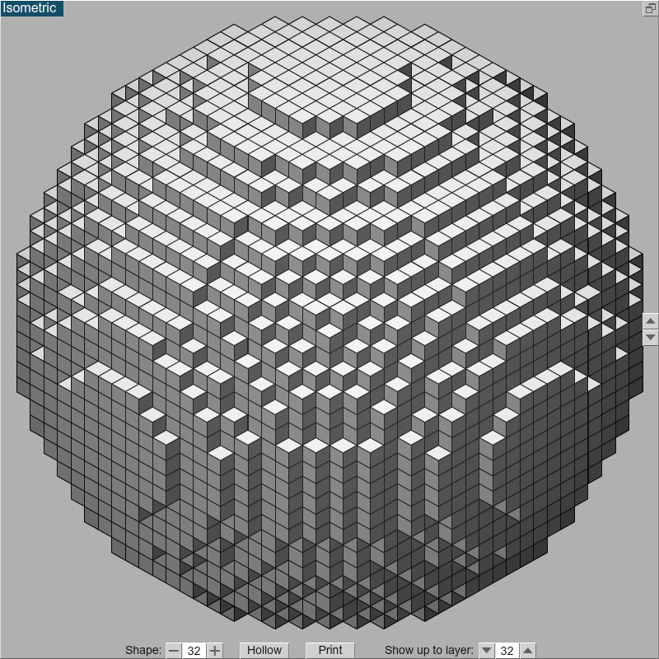
Boundary Conditions
Contravariant coordinates transformation.
Real geometry
Brute force approximation of a sphere

Slide 12
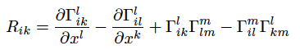
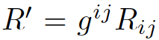
Curved Spaces and Curvilinear Coordinates
Curved spaces, e.g. 2D surface of a sphere:
Ricci scalar or
Curvature Scalar
Ricci curvature tensor
Spherical and cylindrical coordinates represent flat spaces. One can demonstrate:

Slide 13
Some Advantages
Lattice Boltzmann computations in curved spaces and/or curvilinear (cylindrical, polar, etc.) coordinates.
Curved spaces in Cartesian grids due to the contravariant components.
The instabilities due to inertial forces are automatically included.
Low relativistic flow through intrinsically curved spaces, e.g. interstellar media.
Metric tensor and Christoffel symbols can vary with time. Modeling of elastic pipes, vessels, and flow within deformable membranes.
“Exact” representation of the geometry of complex boundaries by using contravariant coordinates.

Slide 14
Some Disadvantages
Unable to model topological singularities: Sphere poles, or regions where the metric tensor has determinant equal zero.
Implementation of boundary conditions when the metric tensor is not diagonal: This depends on the chosen coordinates system.
Boundary conditions for higher order lattices are always a bit more complicated than for standard lattices.

Slide 15
Some Applications

Slide 16
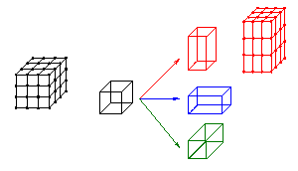
Stretching. Poiseuille Flow

Slide 17
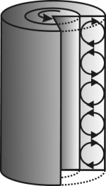
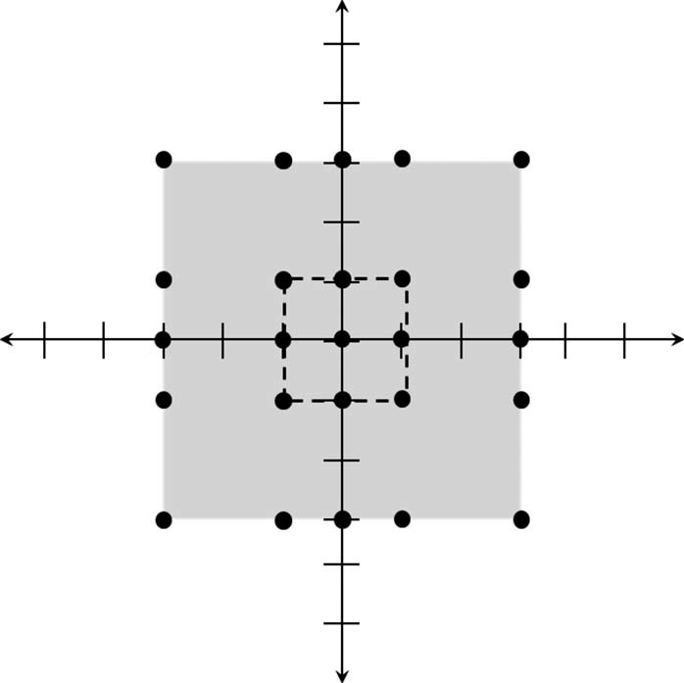
A solution in curvilinear coordinates: Taylor-Couette Instability
z
r
D2Q25
D3Q41

Slide 18
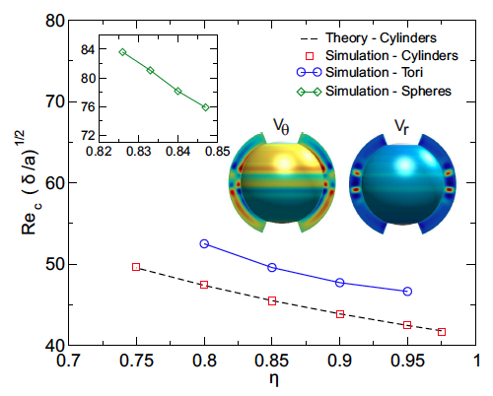
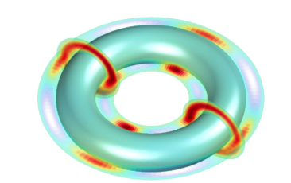
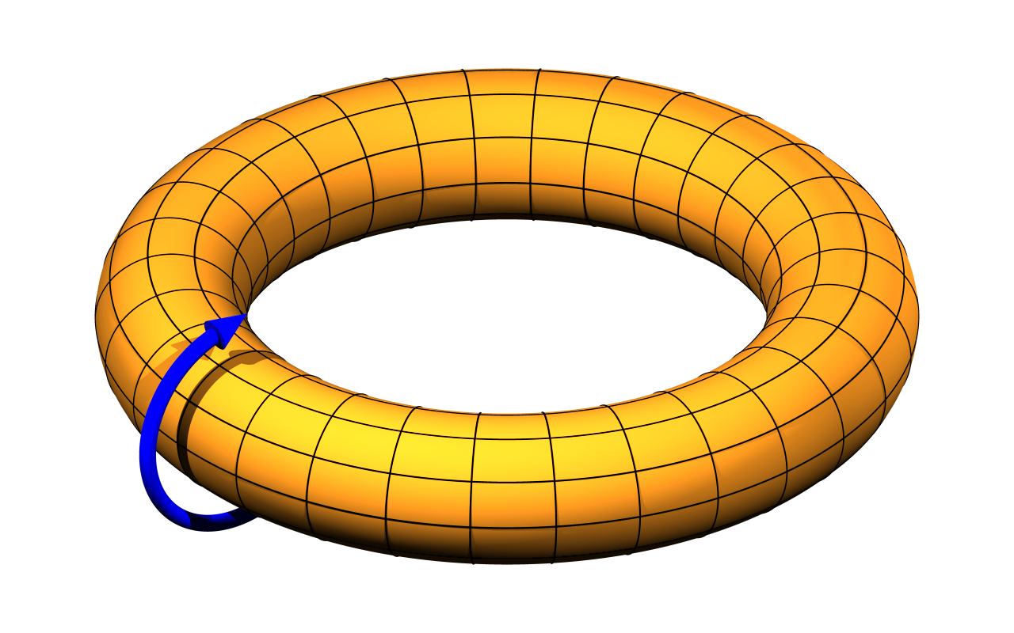
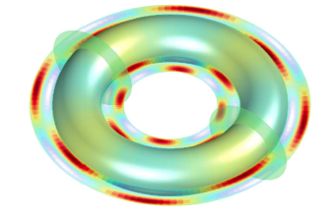
Validation and New Results
Cylinders
Spheres
Tori
r
φ
θ

Slide 19
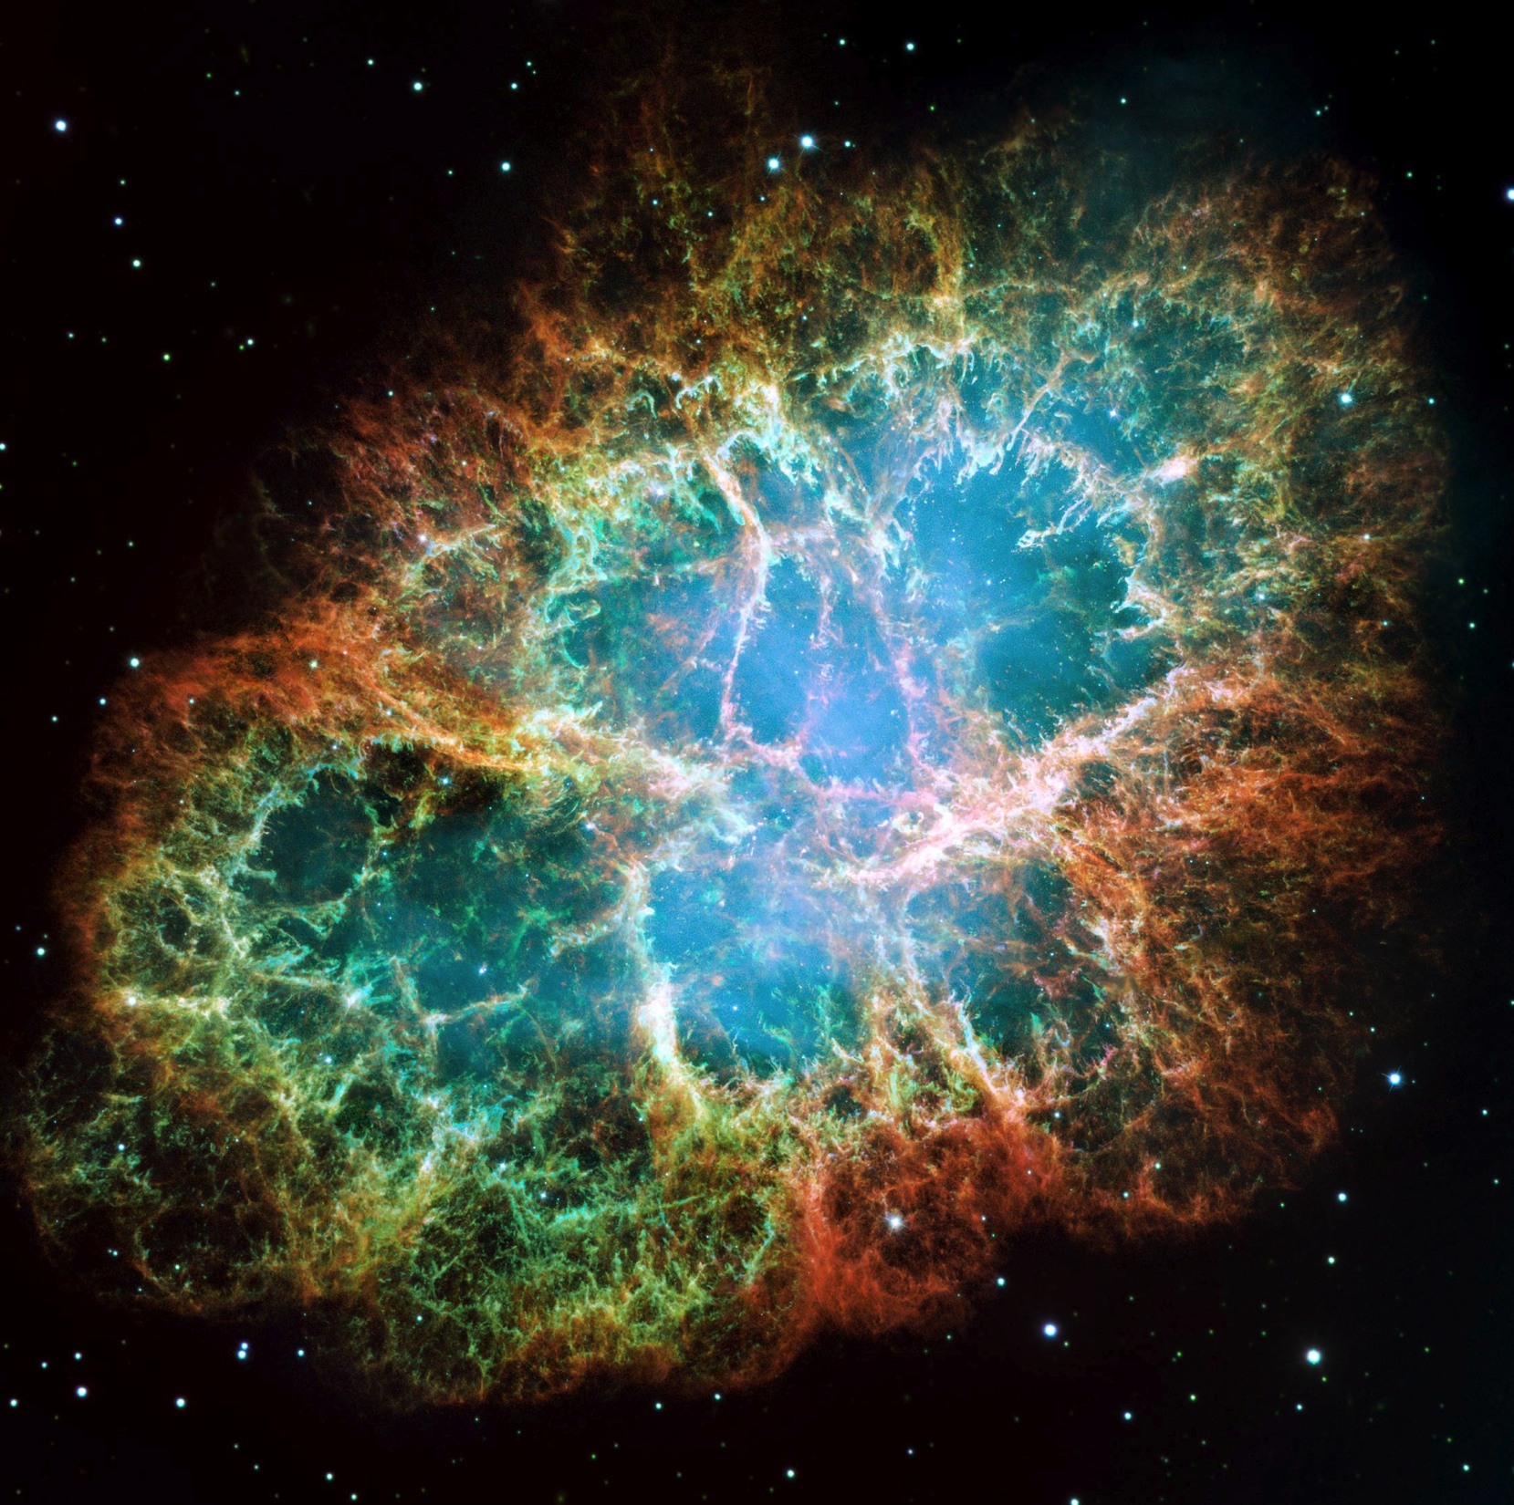
Randomly Curved Space: Campylotic Medium

Slide 20
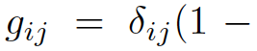
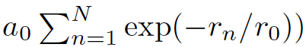
Genuinely Campylotic Medium (Randomly curved space)

Slide 21
Curvature Disordered Media
Flux in absence of impurities
Flux
Number of impurities
Range of curvature perturbation
Ricci or curvature tensor
Ricci or curvature scalar

Slide 22
Curvature Disordered Media
Flux in absence of impurities
Flux
Number of impurities
Range of curvature perturbation
Ricci or curvature tensor
Ricci or curvature scalar

Slide 23
Summary
We have developed a lattice Boltzmann model for general manifolds:
Allows to make computations in virtually any curvilinear coordinate system (polar, cylindrical, spherical, etc.) with LBM.
The LB for manifolds can represent very complex geometries “exactly” in a cubic lattice due to the fact that it works in the contravariant coordinate system, and avoiding a stair case approximation for curved boundary conditions.
Non-inertial forces are automatically included via the Christoffel symbols.
Wave equations can also be modeled with the contravariant components of the coordinates system.
Flow through randomly curved spaces can present very unusual behaviors.

Slide 24
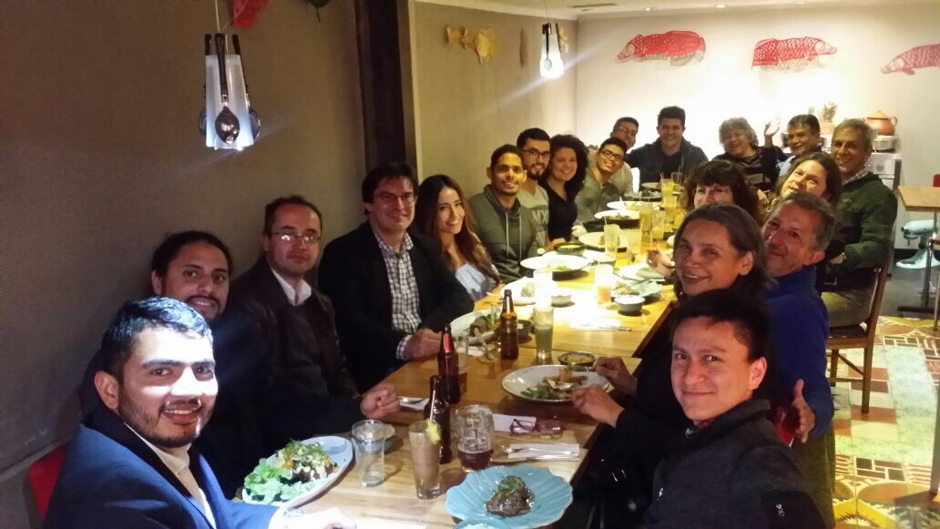
Muchas gracias a todos, especialmente a los organizadores!

